Slide 1
MMA 801 – Introduction to Management
Session Three – Bringing Strategy, Business Model Analysis and Financial Modeling Together
Master of Management in Analytics May 14, 2020 Gary J. Bissonette

Slide 2
MMA 801 – Session 3
Today's Agenda
Agenda Item | Section 1 (Morning) | Section 2 (Afternoon)
Session 2 Review and Spotify Overview | 8:30 am – 9:00 am | 1:00 pm – 1:30 pm
Spotify Mini-case Breakout Room Exercise | 9:00 am – 10:50 am | 1:30 pm – 3:20 pm
Spotify – Team Presentation And Q&A | 10:50 am – 11:10 am | 3:20 pm – 3:40 pm
Spotify & Business Model Analysis – Debriefing | 11:10 am – 12:00 pm | 3:40 pm – 4:30 pm

Slide 3
Business Model Analysis – REview

Slide 4
MMA 801 – Session 3
Mgmt. Decision Legacy
Market Forces
Industry Forces
Company
Current Business System and Model
Profitability and Growth Outcomes
Business System and Model Evaluation
Visually, think of the Challenge and Response in the following manner
Company is defined by an underlying
Structure
Culture
Resources
Talent Pool
Product/ Service Portfolio
Way of Doing Business
Maintain
Build Upon
Rejuvenate
Reinvent
Adjustments to the way we do business
Macro-Economic Forces
Company – 3 Cs
Societal Forces
Competencies
Capabilities
Capacity
Ethics, CSR, Environmental, etc.

Slide 5
MMA 801 – Session 3
Business Model Composition
Culture, Structure & Mgmt. Systems
Customer Value Proposition
(Effective, Reliable, Affordable, Convenient Solutions)
Critical Resources
(People, Assets, Capital, Technology, Brand)
Critical Processes
(Repeatable, Scalable, Sustainable)
Profit Formula
(Revenue model, cost structure, target margins, resource velocity)

Slide 6
MMA 801 – Session 3
Business models reflect 5 "Logical Conclusions" relating to how to compete:
Value Logic
Matching Product/Services to Customer Needs
Market Logic
Demand Creation to Revenue Conversion – are the mechanics in place?
Business Logic
Strategic Initiatives and Outcomes
Value Creation Logic
Resources & Processes – can we deliver?
Risk Logic
Probability success now and going forward

Slide 7
MMA 801 – Session 3
Business Model Composition
Numbers Test
Narrative Test – Your Story
Company-Centric Analysis
Positioning
Market-Centric Analysis
Key Partners
(Backward and Forward… dependencies)
Key Activities
(Value Chain)
Portfolio of Products and Services
Available Customer Segments
(Primary and secondary, size, penetration potential)
Value Proposition
Key Resources
(Composition and velocity)
Customer Relationships
Opportunity Assessment
Market Logic
Underlying Cost Model
(Cost structure and drivers,
scale potential, BEP, etc., capitalization requirements, COC)
Revenue Model
(volume, scope, purchase frequency, sales augmentation, COC, capitalization consumption, ASP degradation)
Culture, Structure and Mgmt. Systems
Adapted from: Business Model Generation, Osterwalder, Pigneur
Notes:
Does your current structure still make sense? Heat map it…where do the key "value" points reside?....Think in terms of maintain, enhance, reduce or remove.

Slide 8
MMA 801 – Session 3
Business Model – Litmus Test
Critical Questions | Audit
Does the underlying value logic around which your business model is designed still resonate with market needs? | Do your products and services still match customer needs.
Is the underlying market logic, relating to how we interact with customers, still valid? | Map the revenue model with customer behaviour and emerging preferences.
Competitive Advantage | Does the current business model facilitate, leverage, and reinforce existing advantages which we possess, relative to rivals?
Does the company's value creation model remain attractive and demonstrates sustainable business returns? | Reassess the profit model, given today's current market dynamics and competitive actions and activities.
Has the risk environment changed? If so, how? Where does the impact lie? | Identify potential risk and probability of occurrence…create a risk inventory.

Slide 9
Financial Reminders

Slide 10
MMA 801 – Session 3
Five fundamental "rules" to keep in mind
Revenue does not guarantee profit.
Profit and Profitability do not guarantee liquidity and/or solvency.
Without a competitive advantage, companies have to compete by lowering the price of the product or service they are selling; this damages gross profit margin.
Managing "cash flow" is what, ultimately, generates wealth.
Return on Invested Capital (ROIC or ROCE) is the core business metric.

Slide 11
MMA 801 – Session 3
Also…
Gross profit margins by themselves do not guarantee profit. The three key killers to gross profit margins are high R&D costs, high selling and administration costs, and high interest costs on debt.
If sales begin to fall, companies can quickly cut product costs. The challenge is how quickly they can cut committed, fixed, and semi-fixed expenses.
The critical line in the income statement analysis is EBT (Earnings Before Tax); this defines the true level of earnings a company is realizing out of its operations.

Slide 12
MMA 801 – Session 3 (Spotify Challenge)
 | Analytical Focus
Strategic Intent | Understanding vision, value, goals, and overarching objectives.
Market Attractiveness and Relative Position | Porter's Five Forces, PESTEL, 3C Analysis…leading to OTWS Analysis, focused on competitiveness, positioning, and strategy execution.
Revenue Model Outlook | Growth rate, historical volatility, sources of revenue… leading to the validity of predictive model. PIMS versus ROS approach. Core understanding of industry specific "comps" in addition to macro-level metrics is required. Competing on price (which means we are competing on cost), or uniqueness/value.
Operating Plan Viability | Asset strength, deployment, velocity. Operational alignment to strategy, achievable financing plan. Cost Base, BEP and CFP.
Economic Performance | Profitability, Cash Flow, Margin Management, Liquidity, Solvency, Volatility, Predictability…trend and Comparatives. ROIC. Unit Profit = Price – Cost.
Adequate Capital | Working Capital, Retained Earnings. Debt and Equity Capacity…amount, timing, duration, deferability, leverage capacity.
Viability Conclusions | Driven from analyses above…covers broad risk range.
Stages of Assessing Financial Requirements and Health

Slide 13
MMA 801 – Session 3
Financial Road Map to Success
ROS emphasis
Revenue model structure & drivers
Revenue
Minus
Margins
Cost base structure & drivers
Costs
Net
Income
Times
Return On
Invested Capital
Divided By
Market
Share
Share of market
Volume
Times
Assets
Deployed
Total available market, & total accessible market
ROIC or ROCE
Market
Size
PIMS emphasis
Invested Capital, Working Capital, tangible asset base

Slide 14
MMA 801 – Session 3
Analytics, AI and Profit Model
Data, Judgement, Actions
Looking to reduce the costs of inputs (prediction)
Recognize and articulate the "ripple" effect of input reduction
Define and Increase the predicted value of outputs
Think beyond operational efficiency to business model transformation
Price Strategies
Margin
Cost Strategies
The critical component here is prediction accuracy…do you know what to predict?
Net Income
Can we increase EBITDA by x%
Market Share
Strategies
Volume
Market Size
Strategies

Slide 15
MMA 801 – Session 3
Customer Base Formula
∆CB = (NC + EC) – DC

Slide 16
Spotify Technology S.A. Case Study Breakout room Exercise

Slide 17
MMA 801 – Session 3
Spotify Guidance Document
Spotify Mini-Case – Course Website
Spotify Supporting Slide Deck – Course Website
Requirement – preparation of a slide deck (one per team)
Electronic posting to the course website
Volunteer team presentations

Slide 18
Spotify Business Model
https://investors.spotify.com/events/investor-day-march-2018/default.aspx
Our Business Model

Slide 19
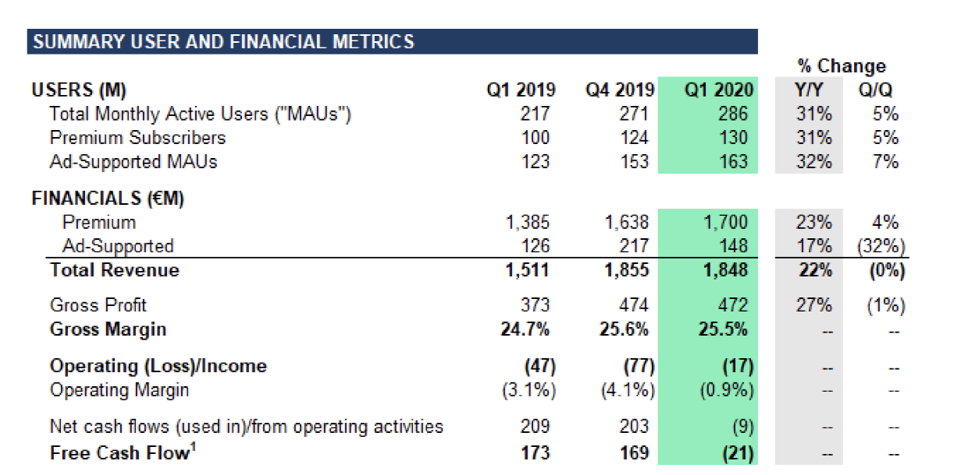
Spotify – Q1 2020 Results

Slide 20
Spotify – Quick Update
First 3 months of 2020
Aggregate MAUs up 31%, and acceleration over Q1 2019.
Revenue growth estimated to be around +22% (YOY)…down from Q4 revenue growth of 31%. Ad supported revenue was down sharply (-32%) from Q4 2019, but up 17% over Q1 2019. This would place annual revenue at an estimated €7.2+B at the end of 2020, if revenue growth is maintained.
Cost of revenue remains constant at ~75% per Euro of revenue. Gross Profit Margin is down 1% QoQ.
Operating loss for first 3 months of 2020 was - €17M. This is expected to deteriorate slightly to year-end do to promotions-based customer acquisition (3 months for $0.99) and increased investment in the "Podcast" portfolio. Desertion rates relating to Covid-19 remain uncertain at this time.
Positive Net Cash Flow and Free Cash Flow were both slightly negative (NCF = €9M and FCF = €21M) in Q1
Company has an estimated €1.8 Billion in liquidity (cash).
Source: CNBC Reporting

Slide 21
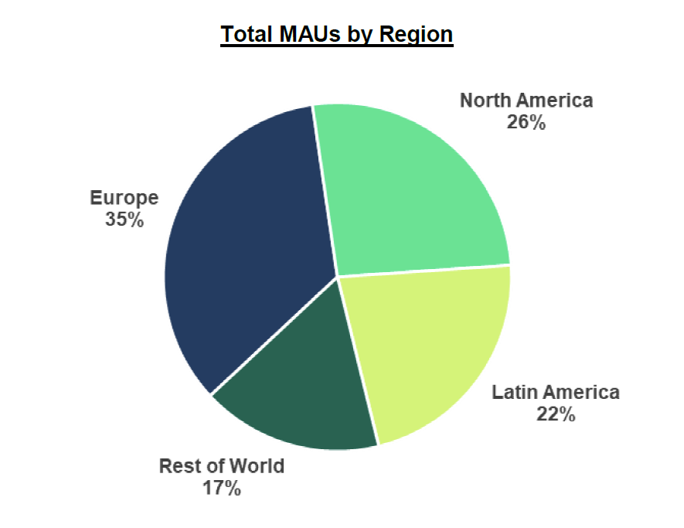
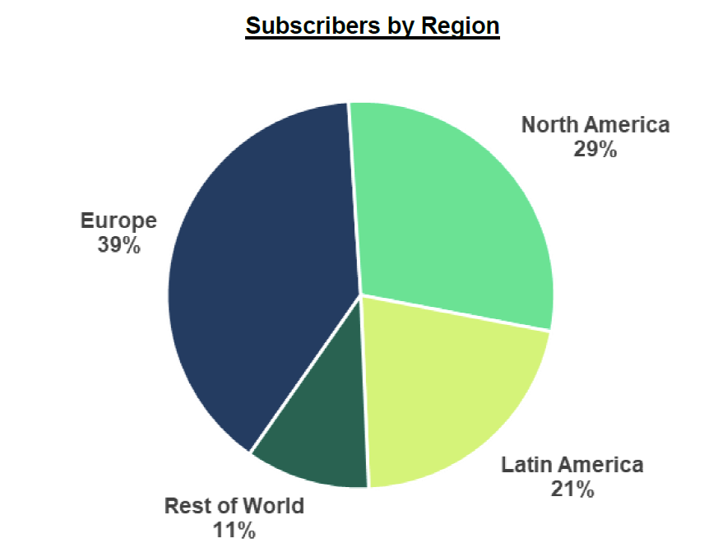
Spotify – Q3 Results

Slide 22
Spotify – Forward Guidance
Q2 2020 Guidance:
● Total MAUs: 289-299 million
● Total Premium Subscribers: 133-138 million
● Total Revenue: €1.75-€1.95 billion
○ Assumes approximately 300 bps headwind to growth Y/Y due to movements in foreign exchange rates
● Gross Margin: 23.3-25.3%
● Operating Profit/Loss: €(45)-€(95) million
○ Includes expected charitable contributions of roughly €(9) million
We are reiterating Full Year 2020 Guidance with the exception of Revenue:
● Total MAUs: 328-348 million
● Total Premium Subscribers: 143-153 million
● Total Revenue: Reduced to €7.65-€8.05 billion from €8.08-€8.48 billion
○ The two biggest drivers of the reduction in revenue guidance relate to changes in foreign exchange rates and changes in our advertising expectations related to COVID-19. F/X is the largest impact accounting for almost half of the change
● Gross Margin: 23.2-25.2%
● Operating Profit/Loss: €(150)-€(250) million

